Slide 1


NRF-NIMS Updates
2010
Matthew P Bernard
NIMS Coordinator
FEMA Region X
September 2010

Slide 2

National Response Framework
Purpose
  Guides how the nation conducts all-hazards incident response
Key Concepts
  Builds on the National Incident Management System (NIMS) with its flexible, scalable, and adaptable coordinating structures
  Aligns key roles and responsibilities across jurisdictions
  Links all levels of government, private sector, and nongovernmental organizations in a unified approach to emergency management
  Always in effect: can be partially or fully implemented
  Coordinates Federal assistance without need for formal trigger
2
Notes:
Notes
NRF guides how the Nation conducts a national response – not just a Federal response – to all hazard incidents.
Document is focused primarily on response; not on prevention, protection or long term recovery. (More to follow)
Important to understand as we focus on the first word – the NRF as a guide to response.
NRF guides by integrating the first three key concepts:
NIMS is an organizational system of positions, interactions, language and processes that already exists, and is well understood by the emergency management community at the local, state and Federal levels. It describes how first responders from different jurisdictions and disciplines can work together. It is flexible, scalable and adaptable to the size and nature of the incident to organize at the right level – local, then state, then Federal. It is a foundational building block of the NRF.
Better than any predecessor document, the NRF defines and aligns the roles of individual citizens; the private sector; non-governmental organizations; local elected or appointed officials; (the Mayor or city manager with his or her local emergency manager and Department and Agency heads); the Governor with his or her State Homeland Security Manager , State Emergency Manager and Department and Agency heads; with the Federal Government starting with the President and describing the roles of the HSC, NSC, the Secretary of Homeland Security, the Attorney General, the Secretary of Defense, the Secretary of State, the Director of National Intelligence and all other Departments and Agencies. And it describes these roles in a response framework that is always in effect – able to be partially or fully implemented – as the incident requires – and without need for a formal trigger or permission to become involved.
The NRF is not about bureaucracy or rigidity, it is about leaning forward in organized partnership with defined roles and responsibilities to contribute to an effective national response to incidents of all types.
National Response Framework

Slide 3
Focused on Response
Achieving a Goal Within a Broader Strategy
Response
  Immediate actions to save lives, protect property and the environment, and meet basic human needs
  Execution of emergency plans and actions to support short-term recovery
National Strategy for Homeland Security – guides, organizes and unifies our National homeland security efforts
  Prevent and disrupt terrorist attacks;
  Protect the American people, our critical infrastructure, and key resources;
  Respond to and recover from incidents that do occur; and
  Continue to strengthen the foundation to ensure our long-term success.
3
Notes:
Notes
While the NRF’s predecessor was called the National Response Plan, it was actually broadly focused and did not sufficiently address critical incident response issues.
The NRF solves this problem by focusing exclusively on response and short-term recovery and dealing directly with roles, responsibilities, and actions required to achieve effective national response.
The NRF is a key component of the National Strategy for Homeland Security that was issued in October 2007.
Reflects our increased understanding of the threats confronting the US, incorporates lessons learned from exercises and real world catastrophes, and articulates how we should ensure our long-term success by strengthening the homeland security foundation. It reiterates four common goals:
Prevent and disrupt terrorist attacks
Protect the American people and our critical infrastructure and key resources
Respond to and recover from incidents that do occur
Continue to strengthen the foundation to ensure our long-term success.
The NRF, along with NIMS, provide the roadmaps for implementing goal #3.
National Response Framework

Slide 4
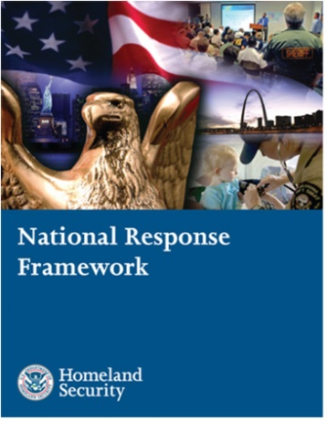
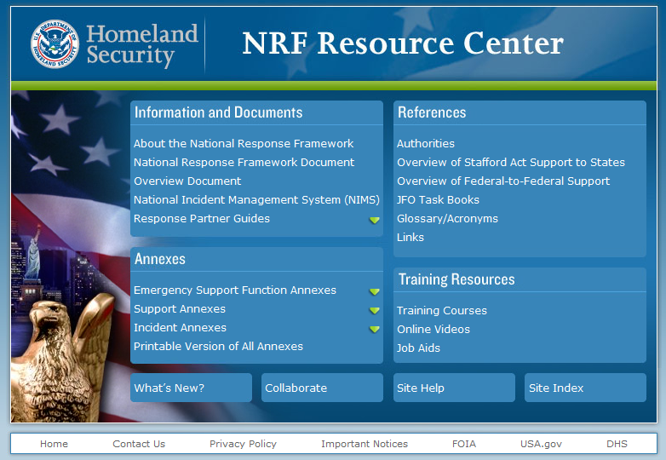
How the Framework is Organized
Doctrine, organization, roles and responsibilities, response actions and planning requirements that guide national response
Core Document
Emergency Support
Function Annexes
Mechanisms to group and provide Federal resources and capabilities to support State and local responders
Support
Annexes
Essential supporting aspects of the Federal response common to all incidents
Incident
Annexes
Incident-specific applications of the Framework
Partner
Guides
Next level of detail in response actions tailored to the actionable entity
www.fema.gov/nrf
4
Notes:
Notes
The NRF is composed of two integrated parts: a printed component and an on-line component.
The printed core document: The core document is the heart of the Framework. It describes response doctrine and guidance; roles and responsibilities; primary preparedness and response actions; and core organizational structures and processes. The core document will be reviewed every four years.
The on-line component: The NRF Resource Center (www.fema.gov/nrf), contains supplemental materials including annexes, partner guides, and other supporting documents and learning resources. This information is more dynamic and will change and adapt more frequently as we learn lessons from real world events, incorporate new technologies, and adapt to changes within our organizations.
Emergency Support Functions (ESFs): The 15 ESFs provide a mechanism to bundle Federal resources/capabilities to support Federal, State, tribal, and local responders. Examples of functions include transportation, communications and energy. Each ESF has a coordinator, primary and support agencies that work together to coordinate and deliver the full breadth of Federal capabilities.
Support Annexes: The 8 Support Annexes describe supporting aspects of Federal response common to all incidents: among them are Financial Management, Public Affairs, Volunteer and Donations Management; Private Sector Coordination and Worker Safety and Health. Each Support Annex has a Coordinating Agency and Cooperating Agencies.
Incident Annexes: The 7 Incident Annexes describe how the Framework will be applied in specific types of incidents: among them, Biological, Cyber, Food and Agriculture, Mass Evacuations, Nuclear/Radiological and Terrorism. Each Incident Annex has a Coordinating Agency and Cooperating Agencies. Note that the Incident Annexes are currently being updated and, in the meantime, the existing Incident Annexes to the NRP remain in effect.
Partner Guides: The Partner Guides provide more specific “how to” handbooks tailored specifically to four areas: local governments; State and tribal governments; the Federal government; and the private sector and nongovernmental organizations.
National Response Framework

Slide 5

State, Tribal & Local Leadership and the Framework
Effective, unified national response requires layered, mutually supporting capabilities
States are sovereign entities, and the Governor has responsibility for public safety and welfare; States are the main players in coordinating resources and capabilities and obtaining support from other States and the Federal government
  Governor
  Homeland Security Advisor
  Director State Emergency Management Agency
  State Coordinating Officer
State & Tribal
Governments
Local
Governments
Indian Tribes. Tribes are sovereign entities. The tribal leader is responsible for the public safety and welfare of The people of that tribe. As authorized by tribal government, the tribal leader is responsible for Coordinating tribal resources, working within the tribal legal framework, negotiate mutual aid and
NRF
Federal
Government
Private Sector
& NGO
assistance from other tribes or jurisdictions and communicate to the tribal community. The tribal leader can also request assistance from;
The Governor of the state to the Federal Government under the Stafford Act
Directly from the Federal Government under the Stafford act once the state governor has requested a presidential declaration on behalf of the tribes.
5
Notes:
Notes
A key concept of the NRF is that effective, unified national response requires layered, mutually supporting capabilities.
The Framework recognizes and builds on the key roles that State and tribal governments plays.
Communities and local jurisdictions are not only the first line of defense when incidents occur, they are also responsible for preparedness and planning efforts.
Successful response begins with effective preparedness by individuals, households, communities, States, and the Federal government.
The Framework emphasizes the role that individuals and households can play in preparing themselves and in supporting community preparedness through initiatives such as Citizens Corps.
National Response Framework

Slide 6
State, Tribal & Local Leadership and the Framework
Effective, unified national response requires layered, mutually supporting capabilities
Local officials have primary responsibility for community preparedness and response
  Elected/Appointed Officials (Mayor)
  Emergency Manager
  Public Safety Officials
Individuals and Households are key starting
points for emergency preparedness and support
community efforts
State & Tribal
Governments
Local
Governments
NRF
Federal
Government
Private Sector
& NGO

Slide 7
Private Sector & NGOs and the Framework
Effective, unified national response requires layered, mutually supporting capabilities
The Private Sector supports community response, organizes business to ensure resiliency, and protects and restores critical infrastructure and commercial activity
NGOs perform vital service missions
  Assist individuals who have special needs
  Coordinate volunteers
  Interface with government response officials at all levels
State & Tribal
Governments
Local
Governments
NRF
Federal
Government
Private Sector
& NGO
7
Notes:
Notes
The Framework systematically incorporates public-sector agencies at all levels with:
Private-sector organizations (business and industry), and
Nongovernmental organizations that play such key roles in response
7
National Response Framework

Slide 8
What is Different About the NRF
A Framework … not a Plan
Written for two audiences
    Senior elected and appointed officials
    Emergency Management practitioners
Emphasizes roles of the local governments, Tribes, States, NGOs, individuals and the private sector
Establishes Response Doctrine
    Engaged partnership
    Tiered response
    Scalable, flexible, and adaptable operational capabilities
    Unity of effort through unified command
    Readiness to act
Establishes planning as a critical element of effective response
8
Notes:
Notes
‘By its name, format, substance and style, the NRF is an almost radical advancement to its predecessor National Response Plan.
In part, one of the significant changes was that it was written with you in mind – a senior government executive, one who has a responsibility to provide for an effective response – as well as for the emergency management practitioner.
As indicated in its purpose, it guides how the Nation conducts an all-hazard response. Other documents describe how we prevent and how we protect, and a future document will describe how we effect long term recovery. The focus is narrowed to response; includes short term recovery.
And, for the first time, the Framework describes five elements of Response Doctrine:
Engaged Partnerships: Avoid dominoes of sequential failure. Layered, mutually supporting capabilities; plan together; understand strengths / weaknesses, know where gaps are. Develop shared goals; align capabilities so none allows other to be overwhelmed. Oklahoma ice storms: generators
Tiered Response: Incidents must be managed at the lowest possible jurisdictional level and supported by additional response capabilities when needed. California Wildfires
Scalable, Flexible and Adaptable Operational Capabilities: As incidents change in size, scope and complexity, the number, type and source of responses must be able to expand to meet requirements.
Unity of Effort through Unified Command: Effective unified command indispensable to all response activities; requires clear understanding of roles and responsibilities; shared objectives. Each agency maintains its own authority, responsibility and accountability.
Readiness to Act: Readiness to act balanced with an understanding of risk. Requires clear, focused communications. Disciplined processes, procedures, systems. From individuals, families, communities to local, State and Federal agencies, national response depends on instinct and ability to act.
Planning - a critical element of effective response.
We are developing a National Planning System to accompany national exercise system. It will provide common planning focus, format; help build capabilities
National Response Framework

Slide 9


The Preparedness Cycle
Evaluate/Improve
Evaluate/Improve
Evaluate/Improve
Evaluate/Improve
•
•
Provides structure and content for
Provides structure and content for
the Comprehensive Assessment
the Comprehensive Assessment
System (under development), State
System (under development), State
Plan
Plan
Preparedness Reports, and the GAP
Preparedness Reports, and the GAP
•
•
•
Provides content and objectives for
Provides content and objectives for
Analysis
Provides content and objectives for
Analysis
planning guides and technical
planning guides and technical
•
planning guides and technical
•
Helps characterize corrective action
Helps characterize corrective action
assistance, e.g., CPG 101
assistance, e.g., CPG 101
processes and improvement plans
assistance, e.g., CPG 101
processes and improvement plans
National
National
The NPG and TCL
The NPG and TCL
•
•
•
Provides target outcomes to plan
Provides target outcomes to plan
drive decisions
Provides target outcomes to plan
drive decisions
Preparedness
Preparedness
against
against
Exercise
against
Exercise
throughout the
throughout the
Guidelines
Guidelines
’
’
preparedness cycle
•
preparedness cycle
•
Provides structure and content for
Provides structure and content for
TCL
HSEEP Exercise and Evaluation
TCL
HSEEP Exercise and Evaluation
Guides
Guides
Organize/Equip
Organize/Equip
•
•
Informs objectives for conducting
Informs objectives for conducting
•
•
•
Provides structure and content for
Provides structure and content for
exercises under the National
Provides structure and content for
exercises under the National
the Cost
the Cost
the Cost
-
-
-
to
to
to
-
-
-
Capabilities Analysis
Capabilities Analysis
Exercise Program
Capabilities Analysis
Exercise Program
(under development)
(under development)
(under development)
•
•
•
Identifies equipment and personnel
Identifies equipment and personnel
Train
Identifies equipment and personnel
Train
needs using NIMS Resource
needs using NIMS Resource
needs using NIMS Resource
Typing & Equipment Lists
Typing & Equipment Lists
•
Typing & Equipment Lists
•
Identifies learning objectives for
Identifies learning objectives for
course development and course
course development and course
selection
selection
•
•
Identifies requisite personnel
Identifies requisite personnel
competencies
competencies
Notes:
9
Key Points
Resource Elements are organized based on the emergency management “preparedness cycle.”
Optional Points
The TCL is designed to serve as a reference document to assist jurisdictions in understanding what actions they need to take to build and sustain capabilities across each phase of the Preparedness Cycle.
Its intent is not to replace discipline-specific efforts already underway among government and private-sector partners, or to replace any of the DHS strategic priorities and policies outlined in the National Incident Management System (NIMS), the National Response Framework (NRF), or the National Infrastructure Plan (NIPP).
Speaker Notes
Presenter may want to first speak broadly about how the NPG and TCL drive decisions throughout the preparedness cycle.
He or she may then go through each step in the cycle (strategy, planning, resources, etc) and describe how the NPG and/or TCL applies specifically to that phase of the cycle.
Emphasize how each individual step is built off the previous step, and feeds into the successive step (e.g. the planning phase is based on the overall strategy, and outlines what resources, training, and exercises are necessary).
Both the NPG and the TCL are actually used and you may not even realize it:
It is closely aligned with NIMS and the NRF, especially with NIMS Resource Typing
It will tie into investment justifications with GPD
FEMA is working internally to align FEMA sponsored training with the TCL and find gaps in training where courses may need to be taught
The TCL is used in EEGs
The TCL will also feed into the CAS (Comprehensive Assessment System) which is currently under development. Once this linkage is solidified the question of if the TCL is an assessment will no longer be as prominent because it will be tangible how the TCL feeds into or informs assessments but is not an assessment in and of itself

Slide 10
What is Next for the NRF
FEMA is working with its partners as directed by a revision to HSPD 8 to set up a series of 4 new National Frameworks including a review and update of the existing NRF by the end of Fiscal Year 2011.
http://www.fema.gov/emergency/nrf/

Slide 11
National Incident Management System (NIMS)
The National Incident Management System (NIMS) released in December 2008 supersedes the March 2004 version of NIMS.

Slide 12
What NIMS Is: | What NIMS Is NOT:
A comprehensive, nationwide, systematic approach to incident management, including the Incident Command System, Multiagency Coordination Systems, and Public Information (HSPD 5,7,8) A set of preparedness concepts and principles for all hazards Essential principles for a common operating picture and interoperability of communications and information management Standardized resource management procedures that enable coordination among different jurisdictions or organizations Scalable, so it may be used for all incidents (from day-to-day to large-scale) A dynamic system that promotes ongoing management and maintenance | A response plan Only used during large-scale incidents A communications plan Only applicable to certain emergency management/incident response personnel Only the Incident Command System or an organization chart A static system

Slide 13
Reorganization Of The NIMS Document
The December 2008 version of NIMS reorders the key components to emphasize the role of preparedness and to mirror the progression of an incident. This will aide in alleviating the misperception that NIMS is only the Incident Command System (ICS).
ORDER OF SECTIONS IN 2004 NIMS ORDER OF SECTIONS IN 2008
Command and Management | Preparedness
Preparedness | Communications and Information Management
Resource Management | Resource Management
Communications and Information Management | Command and Management
Supporting Technologies | Ongoing Management and Maintenance
Ongoing Management and Maintenance | National Integration Center Supporting Technologies

Slide 14
NRF/NIMS Coordination Structures
Field Level
Regional Level
NationalLevel
NIMS Role
Multiagency Coordination System
Homeland
Security
Council
Multiagency Coordination Entity
Strategic coordination
Multiagency Coordination Centers/EOCs
Support and coordination
Joint Field Office
Regional Response Coordination Center
National
Response
Coordination
Center
Local Emergency Operations Center
State Emergency Operations Center
Incident Command
Directing on-scene emergency
management
Role of regional components varies depending on scope and magnitude of the incident.
A Local Area Command is established when needed due to the complexity or number of incidents.
Local
Area
Command
Incident Command Post
Incident Command Post
Incident Command Post
Notes:
The structure for NRP coordination is based on the NIMS that utilizes Incident Command structures on-scene supported by a Multiagency Coordination System, which consists of:
Multiagency Coordination Entities; and
Multiagency Coordination Centers/Emergency Operations Centers.
Reflecting the NIMS construct, the NRP includes the following command and coordination structures:
- ICPs on-scene using the Incident Command System (ICS)/Unified Command;
- Area Command (if needed);
- State, local, tribal, and private sector EOCs;
- JFO, which is responsible for coordinating Federal assistance and supporting incident management activities locally;
- RRCC and HSOC, which serve as regional and national-level multiagency situational awareness and operational coordination centers; and
- IIMG, which serves as the national headquarters-level multiagency strategic coordination entity for domestic incident management.
This structure addresses both site-specific incident management activities and the broader regional or national issues related to the incident.

Slide 15
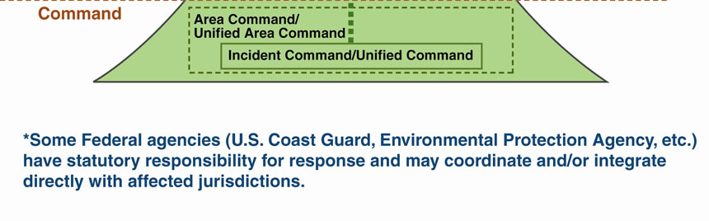
Flow of Requests and Assistance During Large-Scale Incidents

Slide 16
2008 NIMS
COMPONENT-BY-COMPONENT CHANGES AND ADDITIONS
Preparedness
This component was greatly expanded to highlight the importance of preparedness within NIMS, and define its relationship to all other components. Examples include:
Additional roles of elected and appointed officials to define their responsibilities prior to and during an incident
Major Responsibilities of Elected and Appointed Officials
Clearly state agency/jurisdiction policy
Evaluate effectiveness and correct deficiencies
Support a multiagency approach

Slide 17

2008 NIMSCOMPONENT-BY-COMPONENT
CHANGES AND ADDITIONS
Added key roles of NGOs and private sector, detailing how they should be integrated into preparedness efforts
Added information on Continuity of Operations (COOP) and Continuity of Government (COG) planning to help ensure the maintenance of essential functions during incidents
Expanded information on mutual aid agreements and assistance agreements, describing the various types of agreements and the potential elements they should include
Notes:
Automatic Mutual Aid: Agreements that permit the automatic dispatch and response of requested resources without incident-specific approvals. These agreements are usually basic contracts; some may be informal accords.
• Local Mutual Aid: Agreements between neighboring jurisdictions or organizations that involve a formal request for assistance and generally cover a larger geographic area than automatic mutual aid.
• Regional Mutual Aid: Substate regional mutual aid agreements between multiple jurisdictions that are often sponsored by a council of governments or a similar regional body.
• Statewide/Intrastate Mutual Aid: Agreements, often coordinated through the State, that incorporate both State and local governmental and nongovernmental resources in an attempt to increase preparedness statewide.
• Interstate Agreements: Out-of-State assistance through the Emergency Management Assistance Compact (EMAC) or other formal State-to-State agreements that support the response effort.
• International Agreements: Agreements between the United States and other nations for the exchange of Federal assets in an emergency.
• Other Agreements: Any agreement, whether formal or informal, used to request or provide assistance and/or resources among jurisdictions at any level of government (including foreign), NGOs, or the private sector.

Slide 18

2008 NIMSCOMPONENT-BY-COMPONENT
CHANGES AND ADDITIONS
Communications & Information Management
This component was heavily revised to better articulate the importance of communications and information management and is now comprised of three main sections.
Concepts and Principles section contains the following subsections:
  Common Operating Picture
  Interoperability
  Reliability, Scalability, and Portability
  Resiliency and Redundancy

Slide 19
2008 NIMSCOMPONENT-BY-COMPONENT
CHANGES AND ADDITIONS
Resource Management
Improvements include:
Better articulates that the resource management process can be separated into two parts:
  Preparedness (conducted on a continual basis)
  Response (managing resources during an incident)

Slide 20

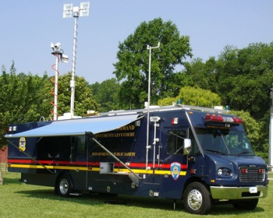
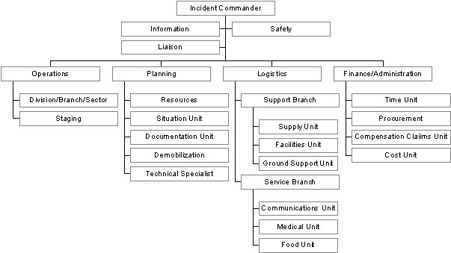
2008 NIMSCOMPONENT-BY-COMPONENT
CHANGES AND ADDITIONS
Command and Management
Most concepts and principles within this component were not altered. Rather, this Component was revised to add clarity and better explain Command and Management concepts and principles, Clarified the purpose of Area Command and how it fits into ICS

Slide 21

2008 NIMSCOMPONENT-BY-COMPONENT
CHANGES AND ADDITIONS
Expanded the Multiagency Coordination System (MACS) section to better define the process of Multiagency Coordination and the elements that make up the System
Replaced the term MAC Entities with MAC Groups
  Major system elements within MACS now include Joint Field Offices (JFOs), Emergency Operation Centers (EOCs) and communications/ dispatch centers.

Slide 22
New Federal NIMS
Implementation Objectives
Now, as of Spring 2010, The Secretary of DHS has authorized a new federal NIMS implementation objectives program to measure NIMS compliance.
This program will require all federal agencies, including FEMA to develop or use their existing NIMS implementation program and meet the federal objectives which cover areas such as training, exercises, and response doctrine.

Slide 23
NIMS Update 2010
The National NIMS 12-2008 document is up for review in 2010. However due to the development of 4 new national frameworks and the update of the NRF, the NIMS update will be postponed until after the new frameworks are published in 2011.
http://www.fema.gov/emergency/nims/index.shtm

Slide 24
Five-Year NIMS Training Plan Update
2009 National Preparedness Training and Exercise Conference
24

Slide 25


Introduction & Background
Five-Year NIMS Training Plan (FYNTP) first published in February 2008
The FYNTP was the culmination of a major effort by the National Integration Center and several working groups consisting of individuals from all levels of government, various disciplines, the private sector and NGO’s
25

Slide 26
Introduction & Background
The primary purposes included:
  Providing stakeholders (especially training administrators) an idea of where NIMS training was headed on a national scale
  Providing definitive guidance on specific NIMS training courses and organizational budget planning efforts

Slide 27
Who must take NIMS and ICS training?
Stakeholders will define the emergency management/response personnel (within their jurisdiction, agency, or organization) required to take ongoing training. This includes all emergency services related disciplines such as: EMS, hospitals, public health, fire service, law enforcement, public works/utilities, skilled support personnel, and other emergency management response, support and volunteer personnel.
Entry Level:
FEMA IS-700: NIMS, An Introduction
ICS-100: Introduction to ICS or equivalent
First Line, Single Resource, Field Supervisors:
IS-700.A, ICS-100, and ICS-200: Basic ICS or its equivalent
Middle Management: Strike Team Leaders, Division Supervisors, EOC Staff, etc.:
IS-700.A, IS-800.B NRF, ICS-100, ICS-200, and ICS-300
Command and General Staff; Area, Emergency Personnel, and EOC Managers:
IS-700.A, IS-800.B NRF, ICS-100, ICS-200, ICS-300, and ICS-400

Slide 28
Five Year Training Plan Update
  The NIMS on line courses outlined in the current 5 year plan are due for implementation this year. However, before the 2009 update to the plan, The NP Deputy Administrator has directed an update to the plan to cover more FEMA training. It is hoped to be out by late Fall 2010 for review.
http://www.fema.gov/emergency/nims/NIMSTrainingCourses.shtm

Slide 29
NIMS ICS All-Hazard Position Specific Training

Slide 30
Introduction
NIMS ICS Position Specific training is designed to provide all-hazards competencies and behaviors for the eight Command and General Staff positions and for certain unit leaders under ICS
  Incident Commander, Safety Officer , Liaison Officer, Public Information Officer, Operations Section Chief, Planning Section Chief, Logistics Section Chief, Finance Section Chief
Resource Unit Leader Course, Situation Unit Leader Course, Communication Unit Leader Course, Supply Unit Leader Course, Finance/Administration Unit Leader Course, Division/Group Supervisor Course, Facility Unit Leader Course
Notes:
NEEP

Slide 31
Introduction (Continued)
The competencies are focused on the ability of student s to assume : the position responsibilities, lead personnel, communicate effectively, and ensure the completion of assigned actions to meet identified objectives for the position
NIMS ICS Position Specific training should be completed by personnel who desire to eventually be certified as a member of a Type III Incident Management Team (IMT) or who desire to seek credentials/certification in an ICS Command and General Staff or unit leader position
More training alone will not necessarily “qualify” a person to serve in an ICS position
  Qualification relies on a combination of training, operational experience, field mentoring, participation in drills, exercises, ICS simulations, etc.
Notes:
NEEP

Slide 32
Assumptions
NIMS ICS Position Specific Training should be conducted by qualified instructors (minimum instructor standards need to be established and adhered to)
The completion of ICS-100, 200, 300 and 400 training does not certify or credential for an ICS position as part of the National Emergency Responder Credentialing System. The completion of ICS training (100 thru 400) does not qualify someone to be an incident commander; or a planning section chief; etc.
http://training.fema.gov/emicourses/allhazardscourses.asp

Slide 33
ICS Position-Specific Training Update
  ICS Position-Specific training is underway and new curricula task books are being developed. Existing qualified instructors are being historically recognized for certification to teach the new curricula. New curricula training is being planned by Idaho with shared region resources. EMI will be hold off campus courses in OR, WA, and ID in spring/summer 2011. The present Position Specific Courses will be reviewed in a year to see if additions or changes are needed and will be all updated at the same time.

Slide 34
Federal NIMS Implementation
Credentialing Guidelines
ICS ER FOG, ICS Forms
Department of Education & NIMS

Slide 35
Credentialing Guidelines
The new guidelines originated from the 2004 credentialing doctrine in the NIIMS. As the development group looked at the issue, it concluded that credentialing has to cover federal, state, local, EMAC critical resources, volunteers and working personnel in critical infrastructure facilities. States will coordinate the entry system and the details of the badging.
The Credentialing Guideline Status--- Based on Public Comments and NP Deputy Administrator direction, the current document is being revised to better address (1) Identity Badge issuance for responders, (2) Management of Responder Qualifications, and (3) Managing Access to Disaster sites - out for comment, late fall 2011.

Slide 36
ICS Emergency Response Field Operations Guide & ICS Forms
This will result in a national guide for Incident Command field operations and planning cycles.
The FEMA ICS Field Operations Guide (FOG) Status - Is in FEMA approval review. Once approved it will proceed to the FEMA Policy Working Group in preparation for Public Comment in the Federal Register.
  ICS Forms Status – Closing comments in the federal register draft ICS forms are close to being finished and should be released within the next three months.

Slide 37
GRANT FUNDING AND NIMS
NIMS compliance (includes ICS training) is a requirement for all federal agencies and all federal grant funds, with the exception of Robert T. Stafford disaster funds and hazard mitigation funds.
http://www.doh.wa.gov/ehp/dw/Security/s-recovery.htm
http://www.fema.gov/emergency/nims/GrantsInformation.shtm
http://www.dhs.gov/xlibrary/assets/grant-program-overview-fy2009.pdf
http://rems.ed.gov/index.php?page=resources_NIMS

Slide 38
Region 10 State NIMS Coordinators
Sarah Puerner, (MVA)
Training Specialist I
Division of Military and Veterans Affairs
Division of Homeland Security and
Emergency Management
Direct: (907) 428-7065
Fax: (907) 428-7009
Toll Free: (800) 478-2337
Email: sarah.puerner@alaska.gov
Gail Baird
Idaho DHS
Emergency Operations Center
Idaho Bureau of Homeland, Security
O: 208.272.3309
C: 208.921.305
Email: gbaird@bhs.idaho.gov
Lonni Nicoll
Domestic Preparedness Planner
Oregon Emergency Management
PO Box 14370, Salem, OR 97301
503-378-2911 Ext. 22233
Email : lonnelle.nicoll@state.or.us
Jim Kadrmas
Washington Military Department
Emergency Management Division
Building 20, MS TA-20
Camp Murray, WA 98430-5112
Email: j.kadrmas@emd.wa.gov

Slide 39
Questions or comments contact:
Matthew P Bernard
NIMS Coordinator
FEMA Region X
425-487-4634
Matthew.bernard1@dhs.gov

